Slide 1









Whiteboardmaths.com
7
2
1
5
© 2004 All rights reserved

Slide 2
Bearings
360/000º
N
1. Measured from North.
060º
2. In a clockwise direction.
60º
270º
W
E
090º
3. Written as 3 figures.
S
180º
N
N
N
315º
W
145º
E
W
E
W
E
230º
315º
145º
230º
S
S
S

Slide 3
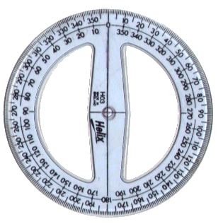
A 360º protractor is used to measure bearings.
Bearings
Use your protractor to measure the bearing of each point from the centre of the circle. (Worksheet 1)
360/000º
350º
N
020º
315º
045º
NW
NE
290º
080º
270º
W
E
090º
250º
110º
SW
SE
225º
210º
135º
S
160º
180º
Worksheet 1

Slide 4
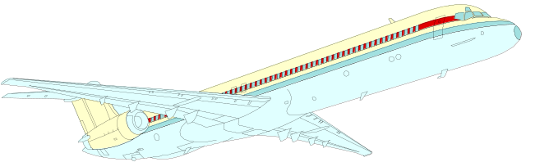
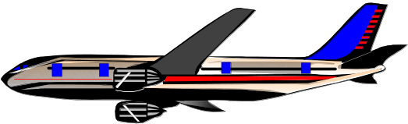

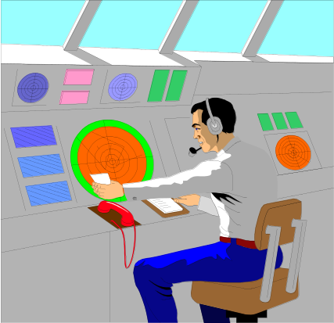
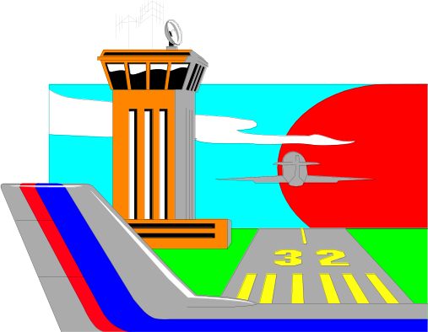
N
360/000º
030º
330º
Estimate the bearing of each aircraft from the centre of the radar screen.
315º
045º
290º
075º
W
270º
090º
E
110º
Air Traffic Controller
Control Tower
250º
135º
225º
170º
200º
180º
S

Slide 5

N
360/000º
010º
325º
7
040º
Estimate the bearing of each aircraft from the centre of the radar screen.
310º
8
1
ACE
Controller
contest
060º
11
12
4
280º
2
W
270º
090º
E
3
5
Air Traffic Controller
Control Tower
250º
10
9
120º
235º
6
195º
155º
180º
Worksheet 2
S

Slide 6
Bearings
Measuring the bearing of one point from another.
To Find the bearing of B from A.
060º
N
B
A
1. Draw a straight line between both points.
2. Draw a North line at A.
Worksheet 3
3. Measure the angle between.

Slide 7
Bearings
Measuring the bearing of one point from another.
To Find the bearing of A from B.
N
B
A
1. Draw a straight line between both points.
240º
2. Draw a North line at B.
Worksheet 3
3. Measure angle between.

Slide 8
Bearings
Measuring the bearing of one point from another.
N
060º
N
B
How are the bearings of A and B from each other related and why?
240º
A
Worksheet 3

Slide 9
Bearings
Measuring the bearing of one point from another.
To Find the bearing of Q from P.
N
P
118º
1. Draw a straight line between both points.
Q
2. Draw a North line at P.
3. Measure angle between.
Worksheet 3

Slide 10
Bearings
Measuring the bearing of one point from another.
To Find the bearing of P from Q.
N
298º
P
1. Draw a straight line between both points.
Q
2. Draw a North line at Q.
3. Measure angle between.
Worksheet 3

Slide 11
Bearings
Measuring the bearing of one point from another.
N
N
298º
P
118º
How are the bearings of P and Q from each other related and why?
Q
Worksheet 3

Slide 12
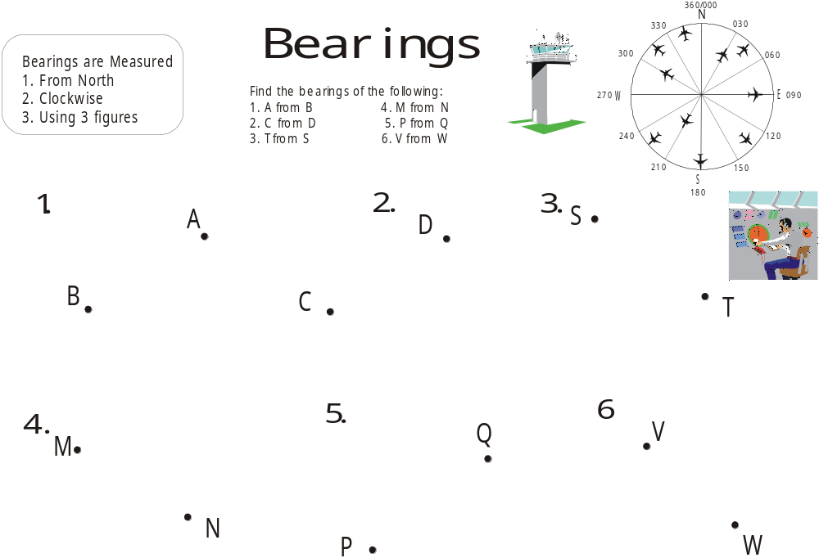
Worksheet 4

Slide 13
Bearings: Fixing Position
Trainee pilots have to to learn to cope when the unexpected happens. If their navigation equipment fails they can quickly find their position by calling controllers at two different airfields for a bearing. The two bearings will tell the pilot where he is. The initial call on the controllers radio frequency will trigger a line on the radar screen showing the bearing of the calling aircraft.
Thankyou
300º
050º
Airfield (B)
306.7 MHZ UHF
Airfield (A)
283.2 MHZ UHF

Slide 14
Bearings: Fixing Position
Trainee pilots have to to learn to be cope when the unexpected happens. If their navigation equipment fails they can quickly find their position by calling controllers at two different airfields for a bearing. The two bearings will tell the pilot where he is. The initial call on the controllers radio frequency will trigger a line on the radar screen showing the bearing of the calling aircraft.
Airfield (A)
283.2 MHZ UHF
170º
255º
Airfield (B)
306.7 MHZ UHF
Thankyou

Slide 15
1. Find the position of a point C, if it is on a bearing of 045º from A and 290º from B.
2. Find the position of a point D if it is on a bearing of 120º from A and 215º from B.
C
B
A
D
Worksheet 5

Slide 16
Bearings
000/360º
N
270º
W
E
090º
S
180º
Worksheet 1

Slide 17
 | My Estimated Bearing | True Bearing | Error
1
2
3
4
5
6
7
8
9
10
11
12
 | Total | Error
 | Average | Error
 | My Estimated Bearing | True Bearing | Error
1
2
3
4
5
6
7
8
9
10
11
12
 | Total | Error
 | Average | Error
Worksheet 2 (Radar)

Slide 18
Bearings
Bearings
1
B
A
P
2
Q
Worksheet 3

Slide 19
Worksheet 4

Slide 20
1. Find the position of a point C, if it is on a bearing of 045º from A and 290º from B.
2. Find the position of a point D if it is on a bearing of 120º from A and 215º from B.
B
A
Worksheet 5

